Slide 1
Bias, Variance and Regularization
Tim Smith, PhD

Slide 2
Linear Regression Review

Slide 3
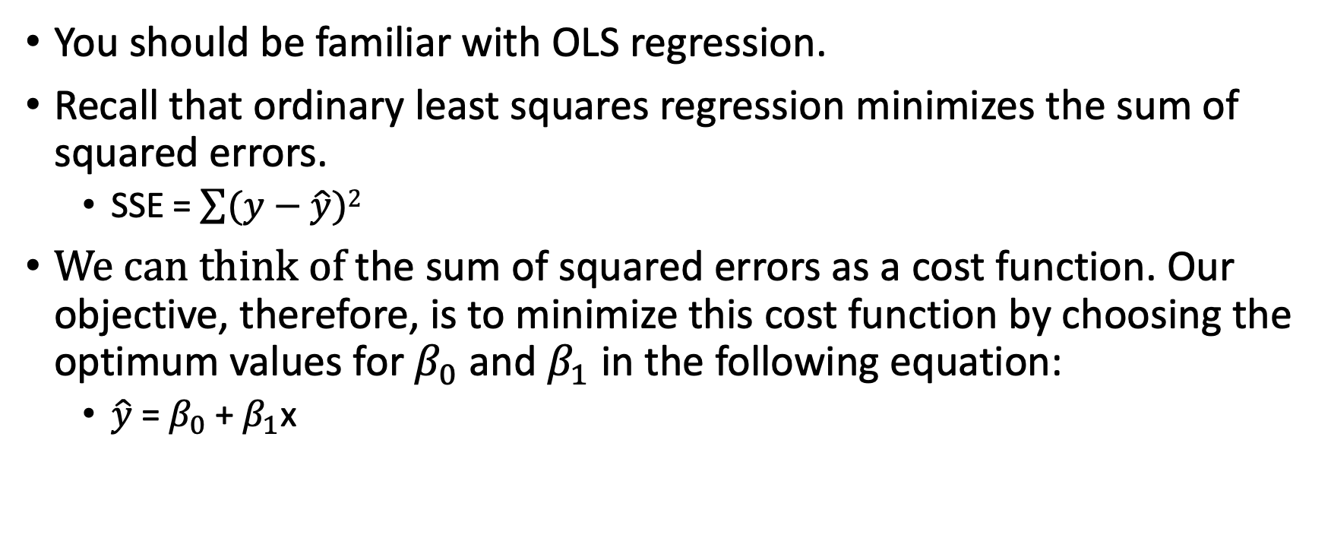
Ordinary least Squares Regression
You should be familiar with OLS regression.
Recall that ordinary least squares regression minimizes the sum of squared errors.
SSE = $\sum{(y−\hat{y})}$²
$We can think of$the sum of squared errors as a cost function. Our objective, therefore, is to minimize this cost function by choosing the optimum values for $β_{0}$ and $β_{1}$ in the following equation:
$\hat{y}$ = $β_{0}$ + $β_{1}$x

Slide 4
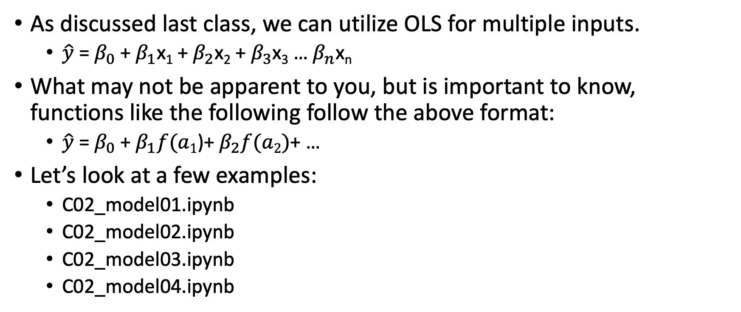
Ordinary Least Squares Regression
As discussed last class, we can utilize OLS for multiple inputs.
$\hat{y}$ = $β_{0}$ + $β_{1}$x₁ + $β_{2}$x₂ + $β_{3}$x₃ … $β_{n}$x_{n}
What may not be apparent to you, but is important to know, functions like the following follow the above format:
$\hat{y}$ = $β_{0}$ + $β_{1}f(a1$)+ $β_{2}f(a2)$+ …
Let’s look at a few examples:
C02_model01.ipynb
C02_model02.ipynb
C02_model03.ipynb
C02_model04.ipynb

Slide 5
What about categorical data?
Input variables can be categorical
As discussed last class, we need to encode such variables using one-hot or dummy encoding.
Once the input variables are encoded, you fit the linear model as you would normally do.
What about target variables?
For binary variables, we can use logistic regression.
For multi-class variables, we can use softmax.
For multi-class nominal variables
encode using one-versus-rest, (OvR) or one-versus-one (OvO).
OVR OR OVO turns the single multiclass nominal target into a number of binary target variables.
For each binary target, we can develop a logistic regression model to predict the target
This is more advanced; and we may cover this later.

Slide 6
Logistic Regression
Regression for binary outcomes
Works just like regular regression
Output is probability of belonging to class 1 (vs. 0)
No known closed-form to find the beta coefficients
Uses gradient descent
Cost function is like a bowl, so guaranteed global minimum
Can be regularized using both L1 and L2

Slide 7
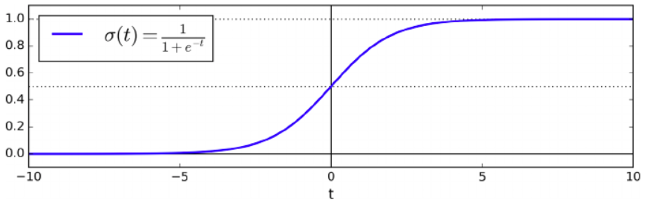

Logistic Regression
The output value is constrained between 0 and 1
Logistic function = $\frac{1}{1+e^{−t}}$

Slide 8
Let’s look at an example…
Let’s look at an example:
C02_model05.ipynb

Slide 9
Not all classification problems are binary classification…
 | Number of Targets | Target Cardinality
Binary Classification | 1 | 2
Multiclass classification | 1 | >2
Multilabel classification | >1 | 2
Multiclass-multioutput classification | >1 | >2

Slide 10
For multiclass-ordinal classification
Input variables can be categorical
As discussed last class, we need to encode such variables using one-hot or dummy encoding.
Once the input variables are encoded, you fit the linear model as you would normally do.
What about target variables?
For binary variables, we can use logistic regression.
For multi-class variables, we can use softmax.
For multi-class nominal variables
encode using one-versus-rest, (OvR) or one-versus-one (OvO).
OVR OR OVO turns the single multiclass nominal target into a number of binary target variables.
For each binary target, we can develop a logistic regression model to predict the target
This is more advanced; and we may cover this later.

Slide 11
OvR
One-vs-rest is a method for using binary classification algorithms for multi-class classification.
OvR approach splits the multi-class dataset into multiple binary classification problems.
Example: Predicting red, blue, green or yellow:
Binary classification problem 1: red vs [blue, green, yellow]
Binary classification problem 2: blue vs [red, green, yellow]
Binary classification problem 3: green vs [red, blue, yellow]
Binary classification problem 4: yellow vs [red, blue, green]
A binary classifier is then trained on each binary classification problem and predictions are made using the model that is the most confident.

Slide 12
OvO
Like one-vs-rest, one-vs-one splits a multi-class classification dataset into binary classification problems.
One-vs-one approach splits the dataset into one dataset for each class versus every other class.
Example: Predicting red, blue, green or yellow:
Binary classification problem 1: red vs. blue
Binary classification problem 2: red vs. green
Binary classification problem 3: red vs. yellow
Binary classification problem 4: blue vs. green
Binary classification problem 5: blue vs. yellow
Binary classification problem 6: green vs. yellow
Each binary classification model may predict one class label and the model with the most predictions or votes is predicted by the one-vs-one strategy.

Slide 13
Softmax Regression
Also known as "Multinomial Logistic Regression."
Used for multi-class classification
Finds probabilities of each class using the softmax function
Class is assigned using the highest estimated probability
It uses the cross-entropy cost function
If classes = 2, reverts back to logistic regression
It uses gradient descent for optimization
we will see gradient descent in the next section of the lecture.
In sci-kit learn set multi_class = 'multinomial’:
softReg = LogisticRegression(multi_class = 'multinomial)

Slide 14
Model Training

Slide 15
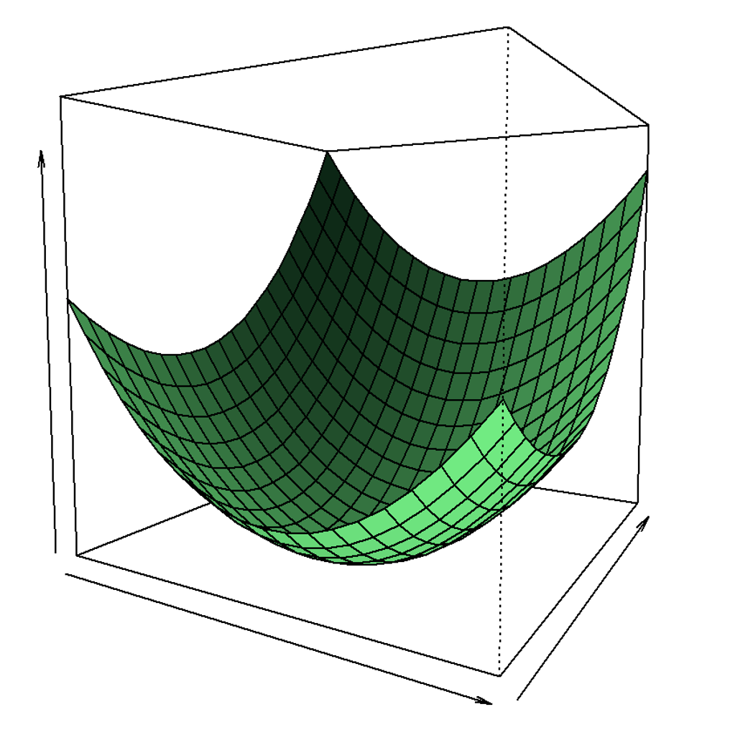



Finding Betas in linear regression
We have some cost function (commonly SSE)
For a simple single variable input, there are two inputs to this function
We need to find the beta1 and beta2 values the result in the lowest RSS/SSE
How do we do that?
$$SSE$$
$$B1$$
$$B0$$

Slide 16
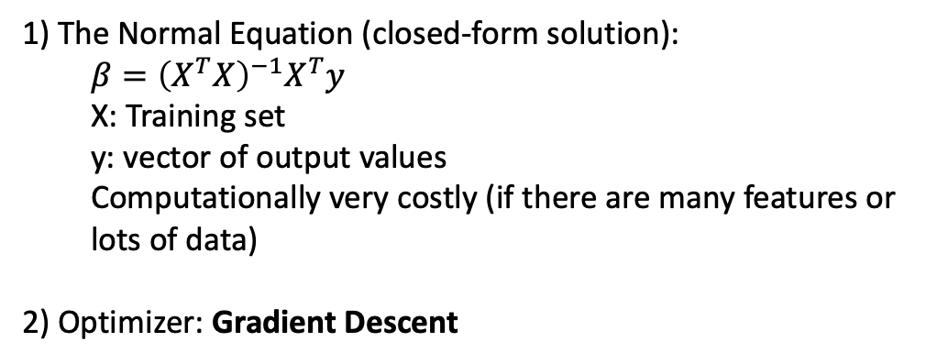
Finding Betas in linear regression
1) The Normal Equation (closed-form solution):
$${β=\left(X^{T}X\right)}^{−1}X^{T}y$$
X: Training set
y: vector of output values
Computationally very costly (if there are many features or lots of data)
2) Optimizer: Gradient Descent
$$SSE$$
$$B1$$
$$B0$$

Slide 17
Finding Betas in linear regression
For simplicity, let’s look at a cost function with one input.
Cost
$$SSE$$
$$B1$$
$$B0$$
Beta value

Slide 18
Gradient Descent
A generic optimization algorithm
Tweak the parameters iteratively to minimize the cost function (SSE/RSS, MSE, RMSE, etc.)
What do you mean by "minimize"???
Lost in a mountain
How do you get to the bottom? (i.e., "minimize")
Feel slope below your feet!
Then, go in the direction of steepest (descending) slope

Slide 19
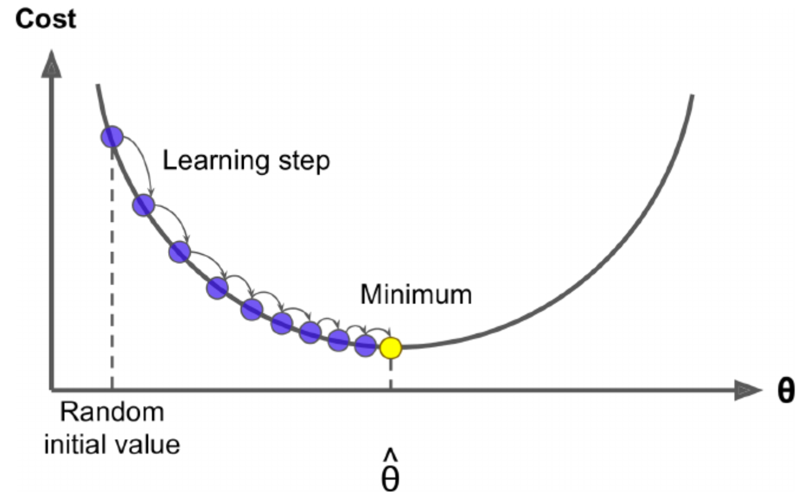
Gradient Descent - Mechanics
Initialize the beta coefficients with random values
Calculate the "gradient" of each beta coefficient
Based on the gradient and "learning rate", change the beta coefficients.
New value = Previous value – learning rate x "gradient value"
If gradient is zero, minimum achieved!

Slide 20
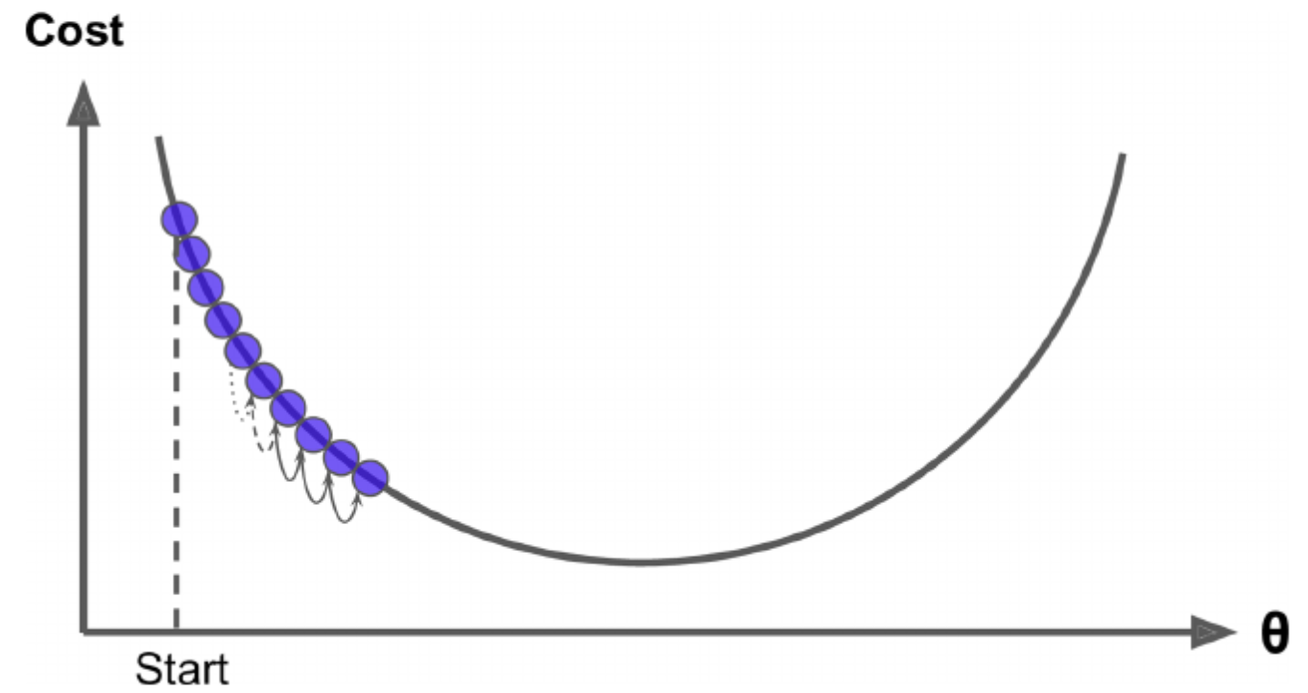
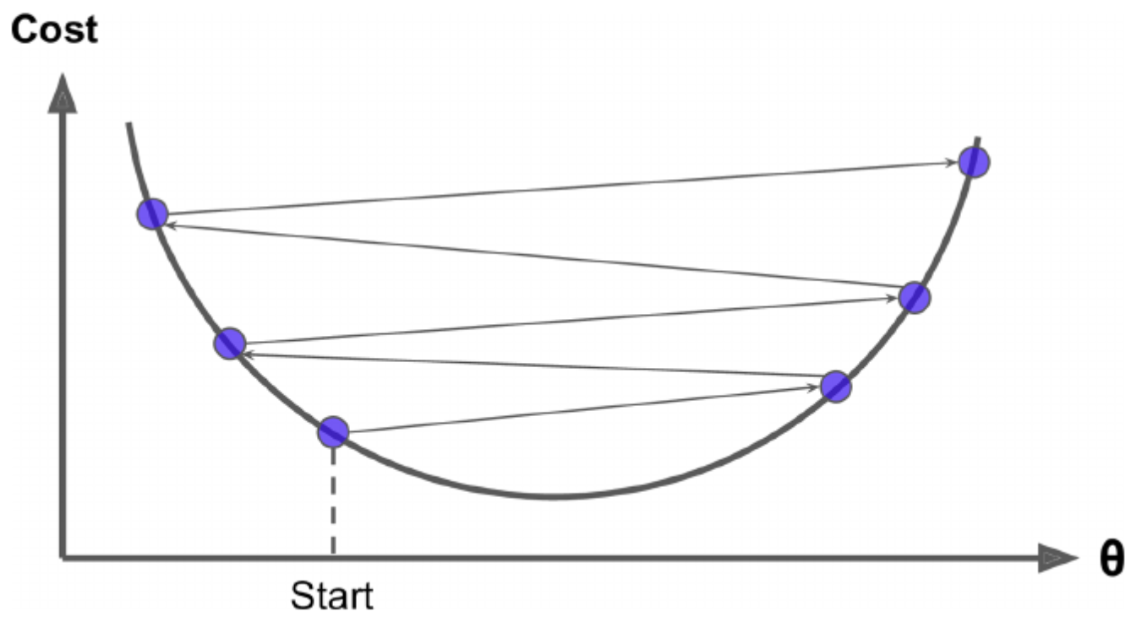
Learning Rate
If too small: too many steps to converge
Might not converge or take too long to converge
It too large: jump around and never reach minimum

Slide 21
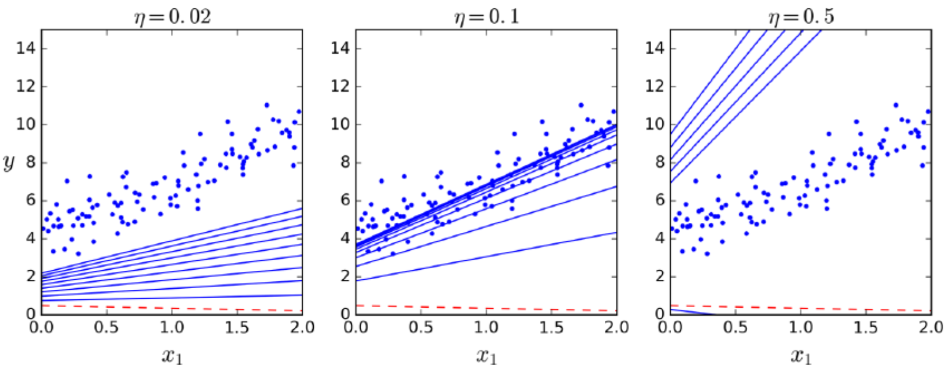
Gradient Descent: Learning Rate
Learning rate too small
Learning rate normal
Learning rate too high

Slide 22
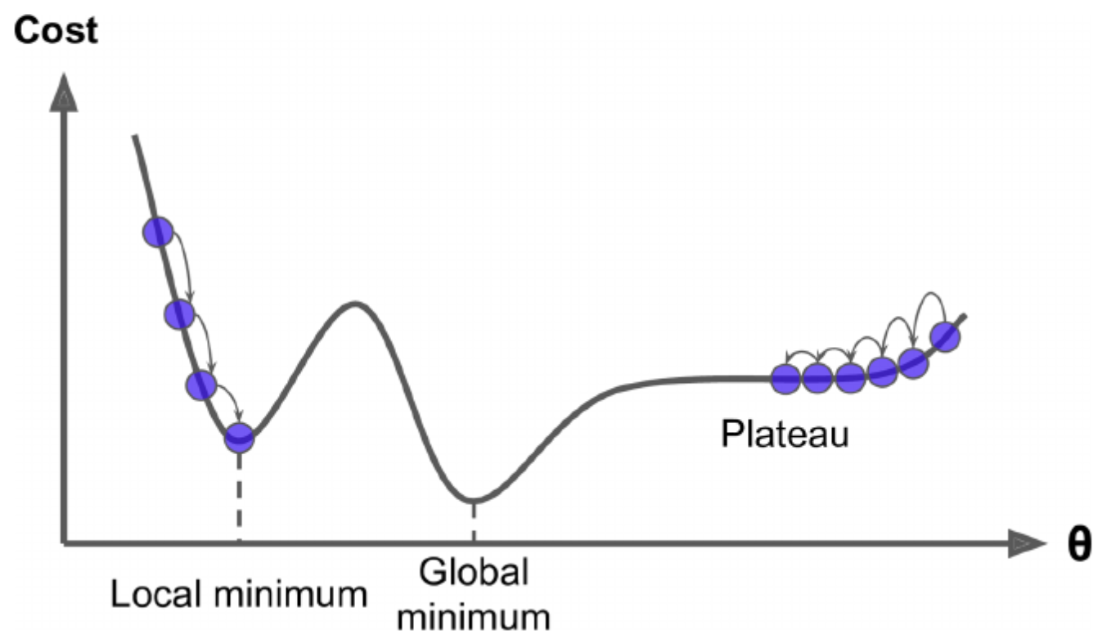
Gradient Descent
Two challenges:
If you are on the left, you will get stuck in the local minimum
If you are on the right, you will get stuck in the plateau

Slide 23
Gradient Descent
For linear models, the cost function (SSE, MSE, etc.) is always shaped like a bowl
Only one global minimum
No local minimum
SSE is a continuous function (the slope doesn’t change abruptly)
So: it is guaranteed to approach a global minimum
However, always standardize your numerical variables.
Non-standardized variables change the shape of the bowl, therefore, you might end up with “plateaus”

Slide 24
A note on standardizing variables
Standardize the input variables when:
Your model contains polynomial terms.
Your model has interaction between terms (i.e., y = b₀ + b₁x₁x₂)
Since standardizing variables in situations other than the above doesn’t impede the modeling training, you often see a rule of thumb be to standardize all input variables.
Downside: Limits interpretability when explaining/understanding the factors possibly influencing the target.

Slide 25
Batch Gradient Descent
Uses the “entire” training set to calculate MSE at every step
Calculate MSE
If the gradient vector points "uphill" go in the opposite direction allowed by the "learning rate"
Repeat
Can be very slow if you have a large set

Slide 26
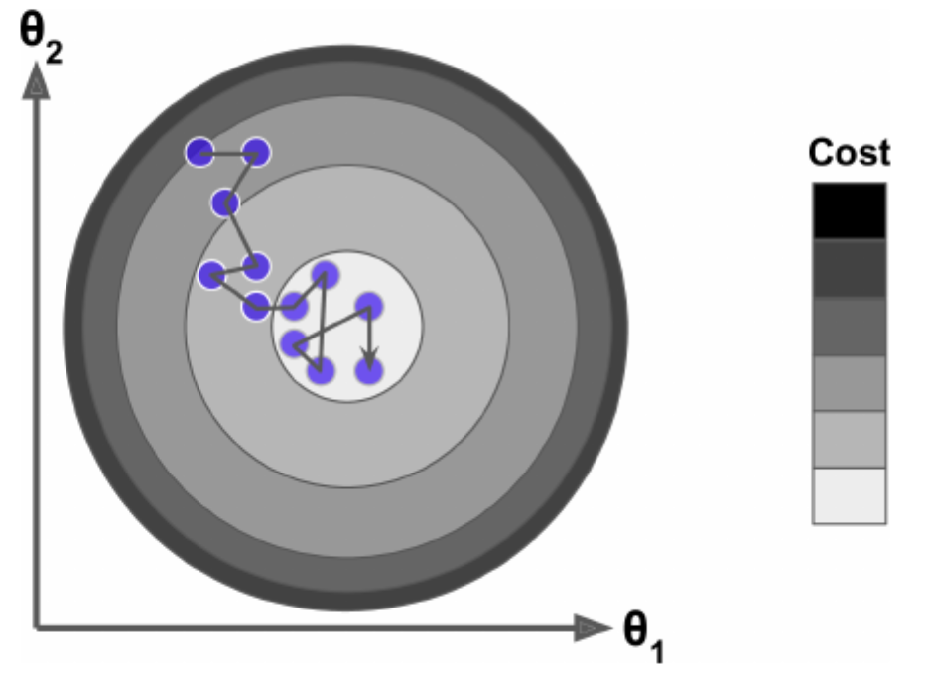
Stochastic Gradient Descent
Stochastic = random
Pick a random instance at every step
Calculate the gradients for that instance only
(Gradient decreases on average)
Much faster than batch gradient
Problem: jumps around (even at global min)
It is instance specific
The final parameter estimates are not optimal

Slide 27
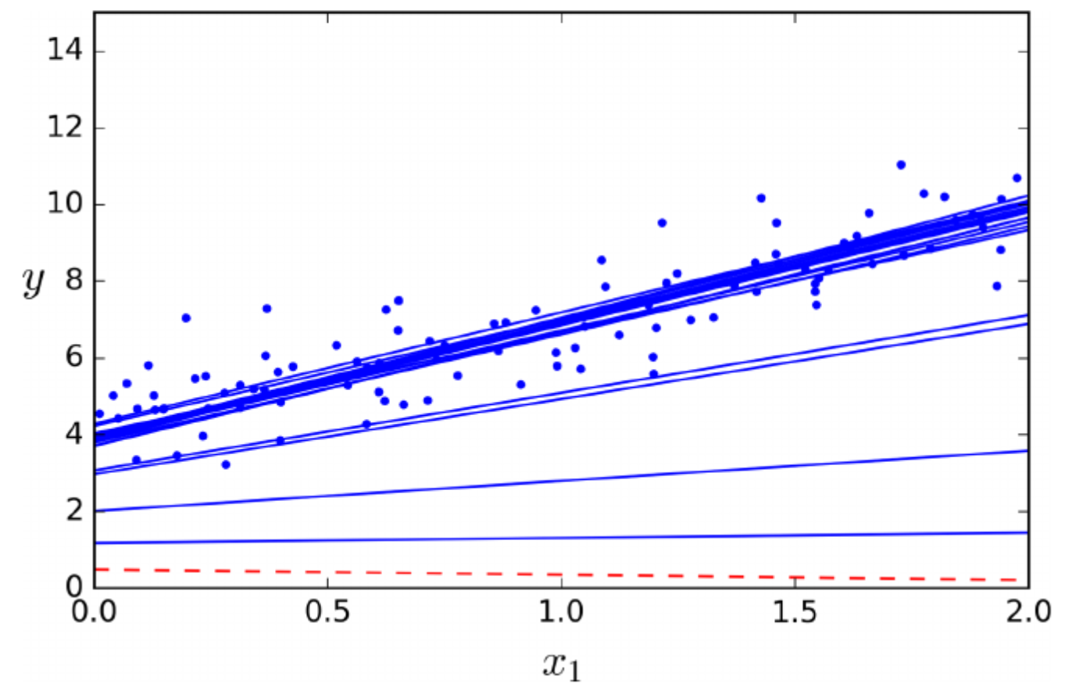
Stochastic Gradient Descent
Better if the cost function is not like a “bowl”
It can get out of local minima
But it can never converge on the minimum
Solution: gradually decrease the learning rate
i.e., “learning schedule”

Slide 28
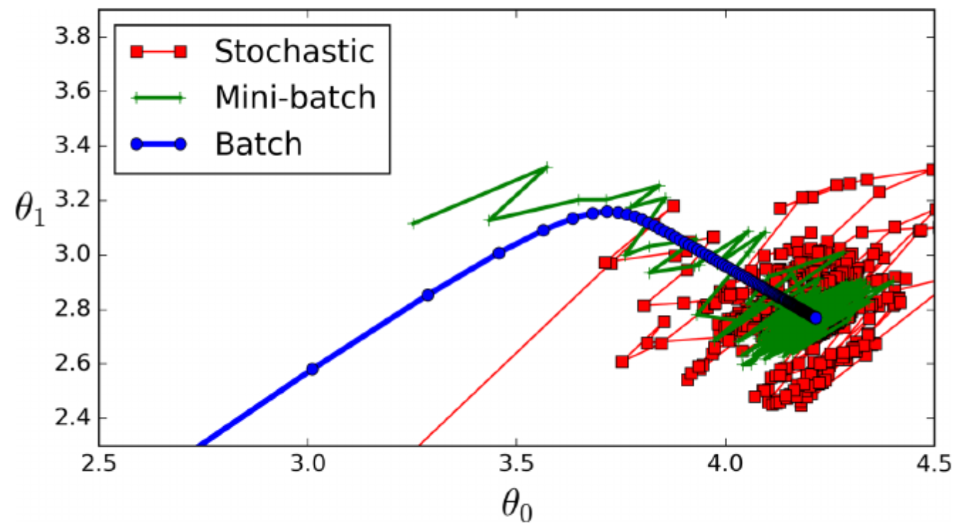
Mini-Batch Gradient Descent
Calculates the gradient on a small subsample (i.e., mini-batch)
Batch uses the entire data set
Stochastic uses one instance at a time
Mini-batch uses a subsample at a time
Less erratic than stochastic gradient

Slide 29
Let’s look at an example…
Let’s look at an example:
C02_model06.ipynb

Slide 30
Regularization

Slide 31
Model Bias
The bias measures how close the model can capture the mapping function between inputs and outputs.
Low Bias: Weak assumptions regarding the functional form of the mapping of inputs to outputs.
High Bias: Strong assumptions regarding the functional form of the mapping of inputs to outputs.
A model with high bias is helpful when the bias matches the true but unknown underlying mapping function for the predictive modeling problem.
Still, such models are only effective if the bias matches the underlying relationship.
Linear model – strong assumptions and high bias
Easy to understand, quick to calculate/compute
Less flexible and low predictive performance on complex problems that do not match underlying simplifying assumptions BUT, if the underlying relationship is, in fact, linear, it will capture the mapping well.
This is also why we often spend a lot of time exploring and hypothesizing about the underlying relationship when using highly biased models.

Slide 32
Variance Error
This is the amount/magnitude of change in predictions if different training data is used.
Low Variance: Changes in training data only result in small changes in prediction(s)
High Variance: Changes in training data result in large changes in prediction(s)
Examples of low-variance machine learning algorithms include:
Linear Regression, Linear Discriminant Analysis and Logistic Regression.
Examples of high-variance machine learning algorithms include:
Decision Trees, k-Nearest Neighbors, and Support Vector Machines.
High variance models will perfectly match the relationship between input and target in the training data but will often predict new data poorly.
We address this by limiting the model’s ability to fit the data (i.e., pruning in decision trees) or utilizing ensemble techniques such as boosting and bagging.

Slide 33
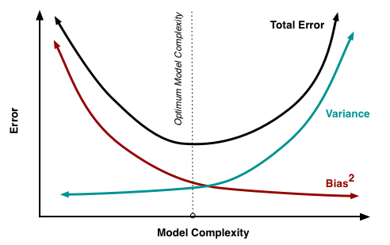
The Error ‘dilemma’…
There is no escaping the relationship between bias and variance in machine learning.
Increasing the bias will decrease the variance.
Increasing the variance will decrease the bias.

Slide 34
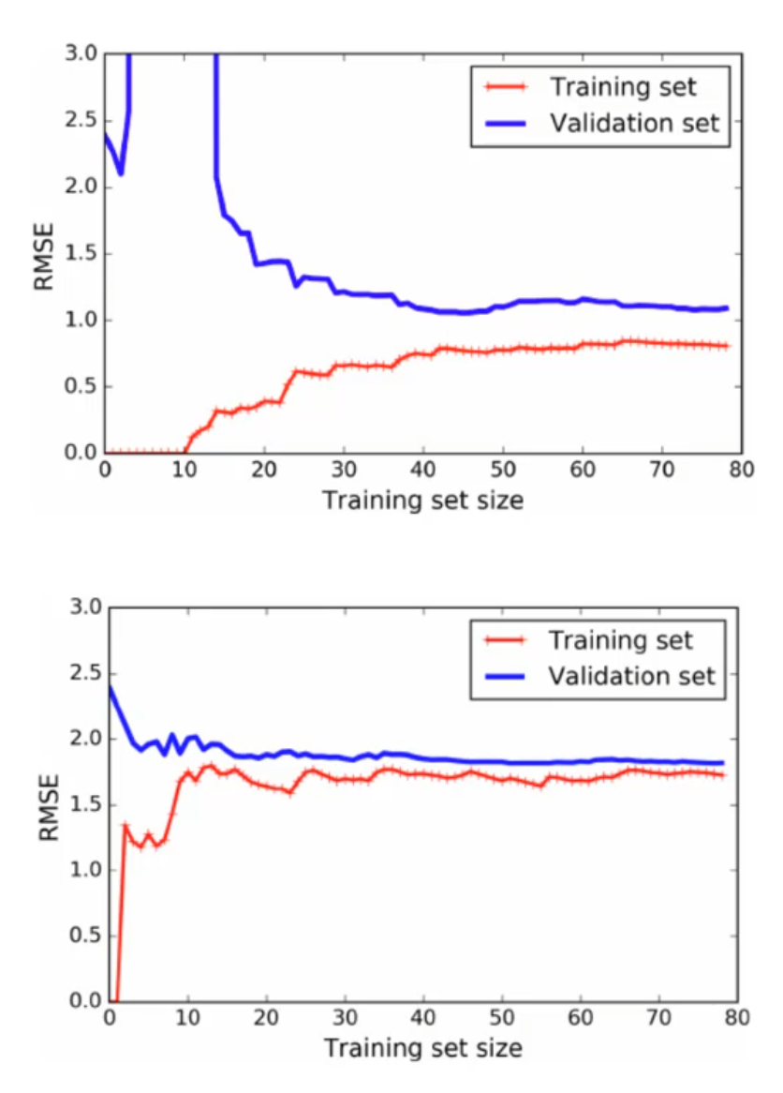
Learning Curves
Overfitting:
Models perform well on training data but not on the test data
Solution: Introduce Bias
Underfitting:
Models perform worse on both
Solution: Reduce Bias

Slide 35
A problem of large linear models
A problem with linear regression is that the model’s estimated coefficients can become large, making the model sensitive to inputs and possibly unstable.
One approach to addressing the stability of regression models is to change the loss function to include additional costs for a model that has large coefficients. Linear regression models that use these modified loss functions during training are referred to collectively as penalized linear regression – and the technique is called ‘regularization’.

Slide 36
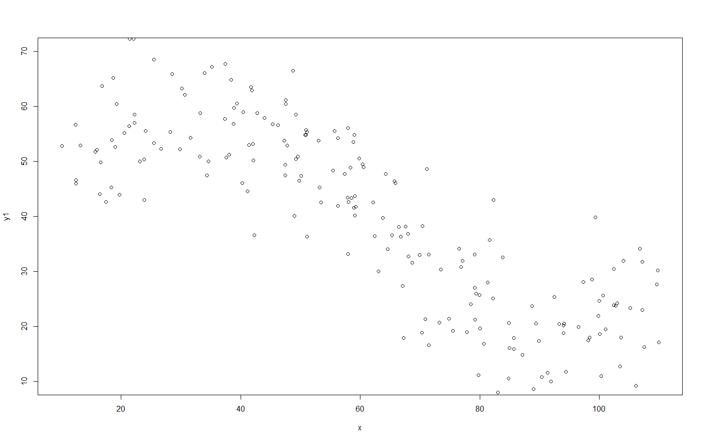
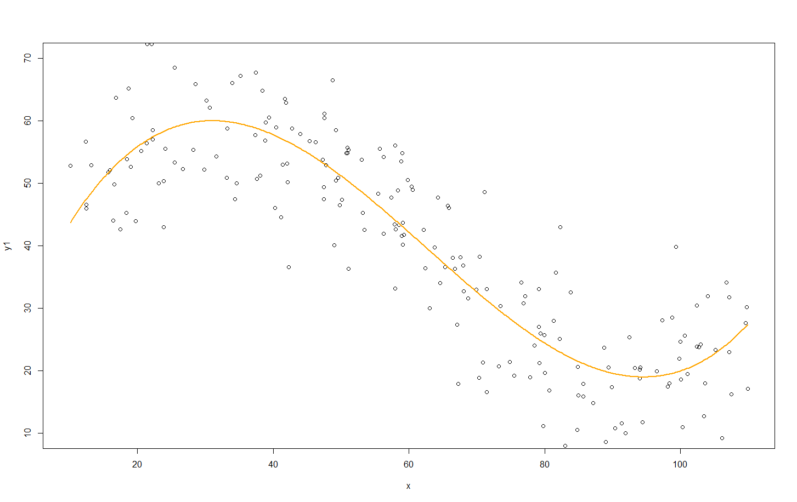
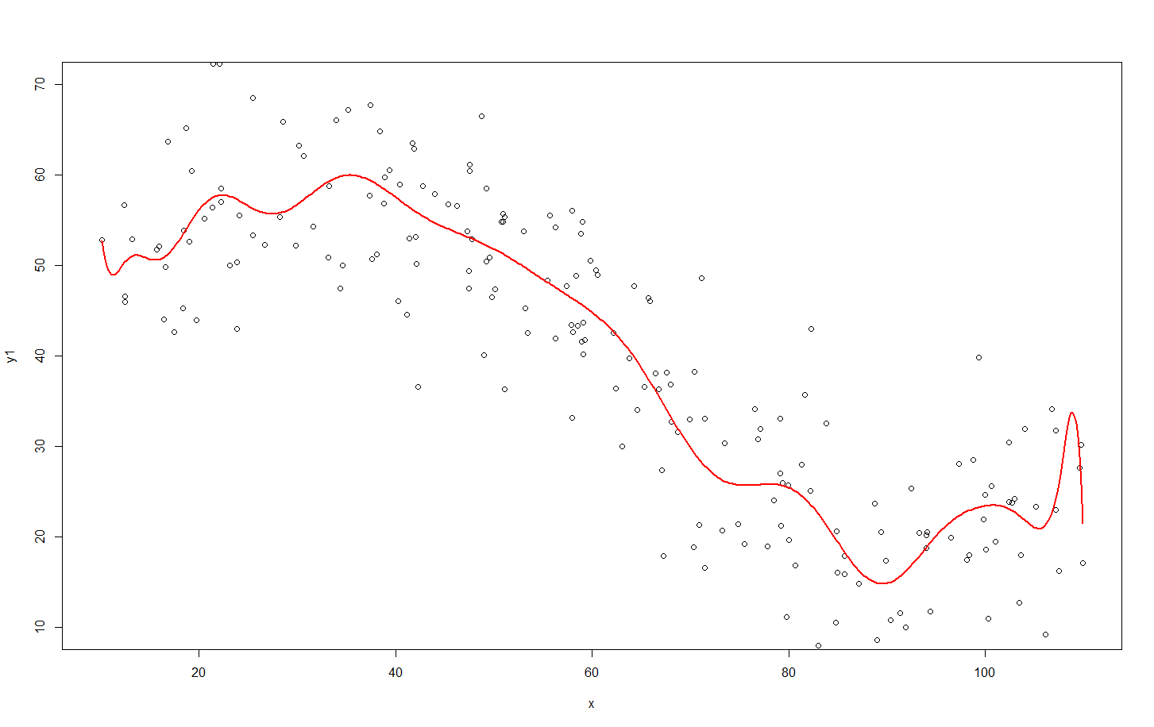
Recall from last class
Y=β₀+β₁x +β₂x²+β₃x³+ β₄x⁴+β₅x⁵+ β₆x⁶+β₇x⁷+ β₈x⁸+β₉x⁹+ β₁₀x¹⁰+β₁₁x¹¹+ β₁₂x¹²+β₁₃x¹³+ β₁₄x¹⁴+β₁₅x¹⁵+ β₁₆x¹⁶+β₁₇x¹⁷+ β₁₈x¹⁸+β₁₉x¹⁹+ β₂₀x²⁰
Y=β₀+β₁x +β₂x²+β₃x³
Y=24.4+3.66x-0.058x²+0.0003x³
Y=11490-4490.9x +777.3x²-78.1x³+ 5.1x⁴-0.29x⁵+ 0.007x⁶-0.00017x⁷+ 2.7*10⁻⁶x⁸-3.12*10⁻⁸x⁹+ … -1.97*10⁻²⁴x²⁰
Set of Predictive Models | Model Fit on Training Data (Sum of Squared Errors) | Model Fit on Test Data (Sum of Squared Errors)
#1) Y=β₀+β₁x | 10.71 | 10.31
#2) Y=β₀+β₁x β₂x² | 9.94 | 10.21
#3) Y=β₀+β₁x +β₂x²+β₃x³ | 7.64 | 8.99
#4) Y=β₀+β₁x +β₂x²+β₃x³+ β₄x⁴+β₅x⁵+ β₆x⁶+β₇x⁷+ β₈x⁸+β₉x⁹+ β₁₀x¹⁰+β₁₁x¹¹+ β₁₂x¹²+β₁₃x¹³+ β₁₄x¹⁴+β₁₅x¹⁵+ β₁₆x¹⁶+β₁₇x¹⁷+ β₁₈x¹⁸+β₁₉x¹⁹+ β₂₀x²⁰ | 7.38 | 9.19

Slide 37
Regularization:
A technique to reduce overfitting
It introduces bias into the model
A technique to "penalize the model complexity" (so you don't learn too much)
"Constrains" the weights (i.e., betas) of the model
Several regularization techniques:
L2 Regularization (i.e., Ridge Regression)
L1 Regularization (i.e., Lasso Regression)
Elastic Net (combination of L2 and L2)
Another approach: Early stopping

Slide 38
L2 Regularization (Ridge Regression)
Goal: model simplicity
A regularization term is added to the cost function
Forces the algorithm to keep the beta coefficients as small as possible
Used only in training
Validation is performed on unregularized model

Slide 39
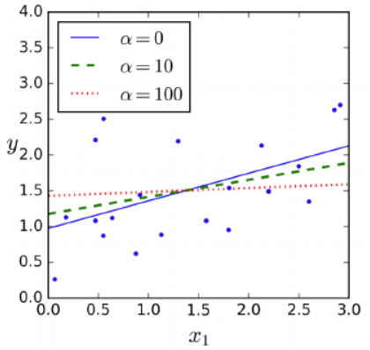
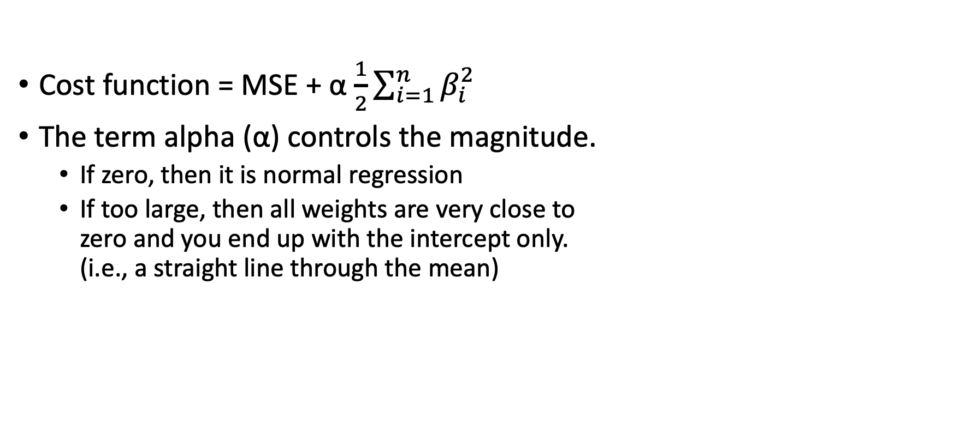
L2 Regularization (Ridge Regression)
Cost function = MSE + α $\frac{1}{2}\sum_{i=1}^{n}{β_{i}^{2}}$
The term alpha (α) controls the magnitude.
If zero, then it is normal regression
If too large, then all weights are very close to zero and you end up with the intercept only. (i.e., a straight line through the mean)
alpha value
Complex model (overfitting)
Very simple model (underfitting)
Very low
Very high

Slide 40
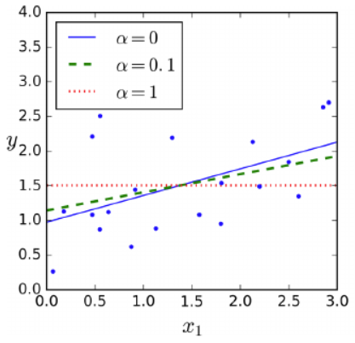
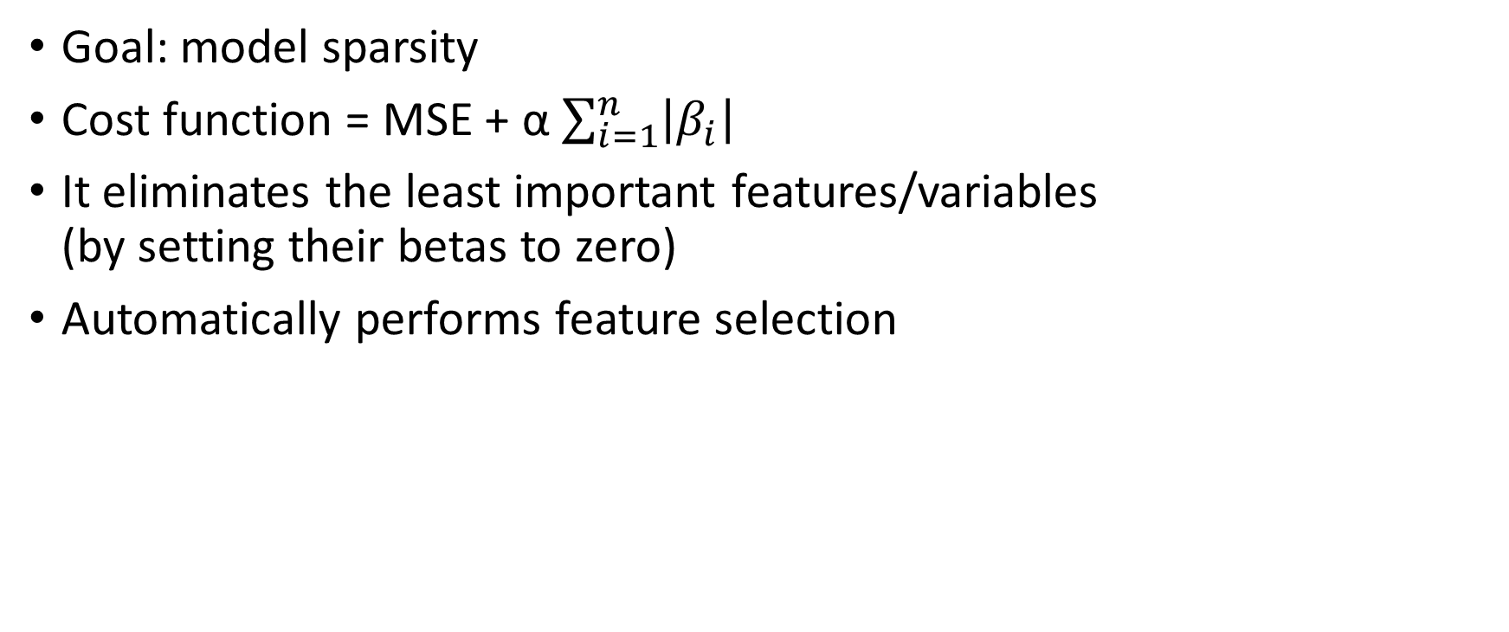
L1 Regularization (Lasso Regression)
Goal: model sparsity
Cost function = MSE + α $\sum_{i=1}^{n}{\left|β_{i}\right|}$
It eliminates the least important features/variables (by setting their betas to zero)
Automatically performs feature selection

Slide 41
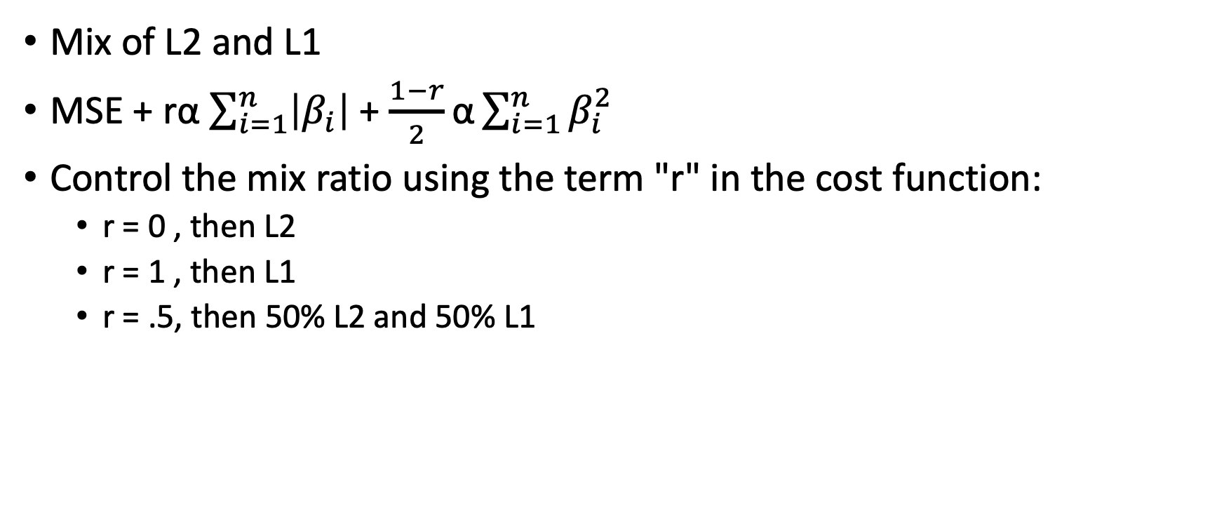
Elastic Net
Mix of L2 and L1
MSE + rα $\sum_{i=1}^{n}{\left|β_{i}\right|}$ + $\frac{1−r}{2}\text{α}\sum_{i=1}^{n}{β_{i}^{2}}$
Control the mix ratio using the term "r" in the cost function:
r = 0 , then L2
r = 1 , then L1
r = .5, then 50% L2 and 50% L1

Slide 42
Traits
L2 tends to lower the value of the coefficients but not remove them
L1 tends to lower the value for some coefficients to zero, thus completely removing the influence of a variable.
ElasticNet is a combination of the two
Try both, but
L1 is good at addressing the problem of many variables – certain variables can be removed, and the computational costs of training a model are reduced.
L2 is good at reducing the influence of variables but not eliminating them. Thus, are good in situations where you have few variables (as compared to ‘many variable’).
ElasticNet – a combination of both, thus, hitting a balance between the two approaches.
Which is ‘best’?
Try them, and choose which one performs better.

Slide 43
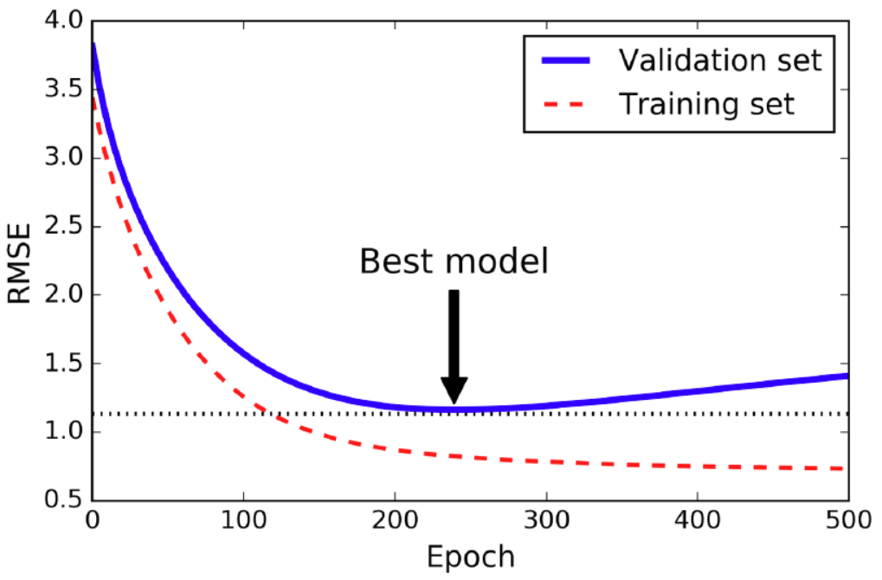
Early Stopping
Another regularization technique: stop when validation error is minimum
Is it baked into the algorithms?
Yes&No
(Sometimes, you have to write your own)

Slide 44
Let’s look at an example…
Let’s look at an example:
C02_model07.ipynb

Slide 45
Conclusion
Linear Regression
Single input variable
Multiple input variables
Seemingly ‘non-linear’ relationships
Polynomial
Etc.
Logistic Regression
Binary
Multinomial (Softmax)
Classification
Binary Classifier
Multiclass Classifier
Multilabel Classifier
Multiclass-multioutput classification
Model Training
Closed-form solution
Gradient Descent
Stochastic gradient descent
Batch/mini-bath gradient descent
Bias vs Variance
Understanding underfitting and overfitting from Bias and Variance
Regularization – ‘biasing’ the model
L1
L2
ElasticNet
And other techni ques: i.e. Early stopping

Slide 46
This week
Complete the ICP02 assignment before you leave (you have until tonight at 11:59 pm to submit it)
Complete the Weekly exercise and submit this before Sunday 11:59 pm.
Continue working on your DataCamp courses.

Slide 47
Next week
Creating Classifiers
Classifier Model Evaluation
SVM (Support Vector Machines)
Other IDE’s
VSCode
Using Code-Pilot (AI Assisted Coding)
Working with Repos
Accessing class repo
Accessing your personal repo

